Slide 1


Case-control study
2020/10/14

Slide 2

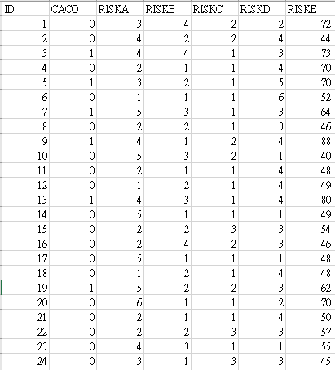
 Outcome variable
Demo 資料，非作業資料
 Binary (case/control)
Predictor variables
Continuous
Age, Height…
Categorical
Gender
Ordinal
Ranked/ordered
Education(Low/Median/High)
Multiple Variables
Logistic regression

Slide 3
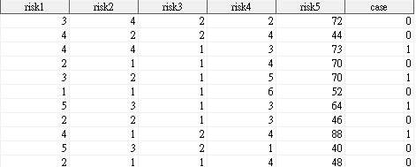
文字變項改成數字
/*convert character into numeric*/
DATA a;
SET data;
risk1=riskA*1;risk2=riskB*1;risk3=riskC*1;
risk4=riskD*1;risk5=riskE*1;case=caco*1;
RUN;

Slide 4
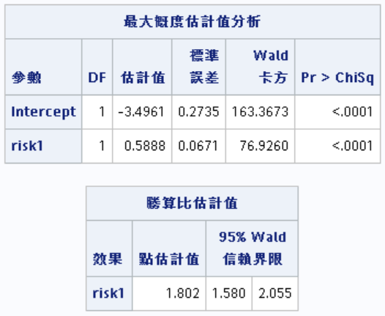
Model
– Logit(p) = ln
OR= e^{βi}
odds
(p/1-p
) =α+β₁x₁+ β₂x₂+…
case=1;control=0
/*linear trend*/
PROC LOGISTIC DESCENDING DATA=a;
MODEL case=risk1;
RUN;
β_{i}
x_{i}每增加一個單位,
罹病的危險性增加e^{βi}倍
e^{βi}

Slide 5
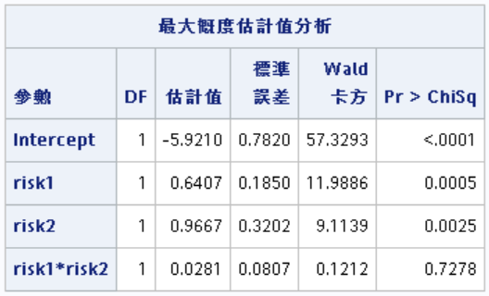
Interaction
/*interaction*/
PROC LOGISTIC DESCENDING DATA=a;
MODEL case=risk1 risk2 risk1*risk2;
RUN;
Main effects
Interaction term
控制其他變項後,
x_{i}每增加一個單位,
罹病的危險性增加e^{βi}倍
β_{i}
No interaction

Slide 6
Dummy variables_1
Categorical variables (m levels)
create m-1 dummy variables
Blood type | Dummy 1 | Dummy 2 | Dummy 3
A | 0 | 0 | 0
B | 1 | 0 | 0
O | 0 | 1 | 0
AB | 0 | 0 | 1

Slide 7
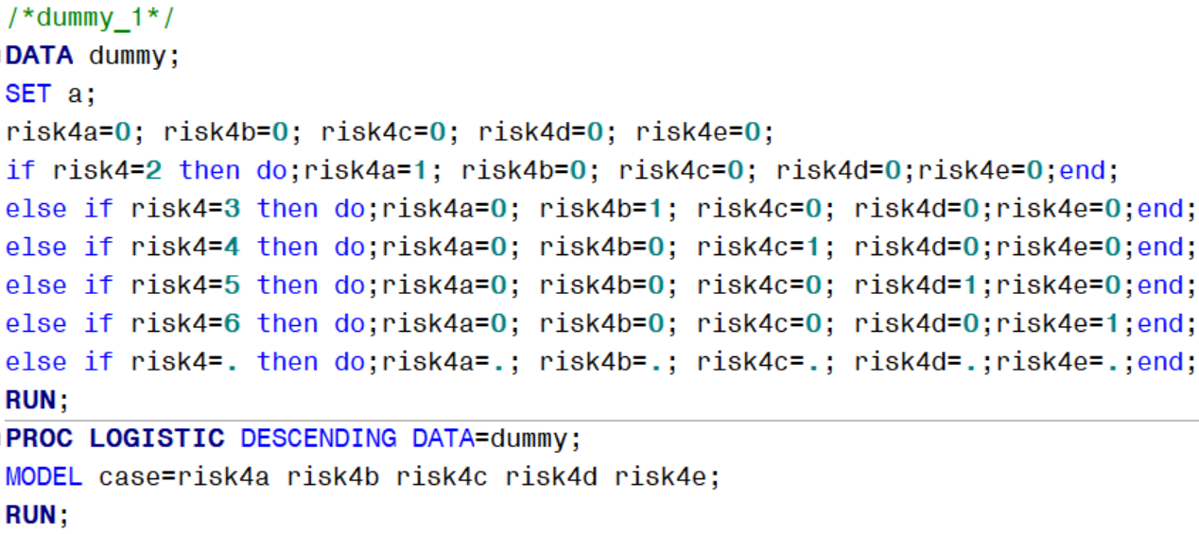
Dummy variables_1
risk4 | risk4a | risk4b | risk4c | risk4d | risk4e
1 | 0 | 0 | 0 | 0 | 0
2 | 1 | 0 | 0 | 0 | 0
3 | 0 | 1 | 0 | 0 | 0
4 | 0 | 0 | 1 | 0 | 0
5 | 0 | 0 | 0 | 1 | 0
6 | 0 | 0 | 0 | 0 | 1

Slide 8
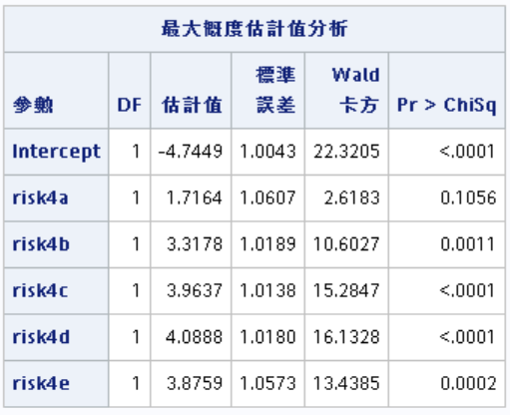
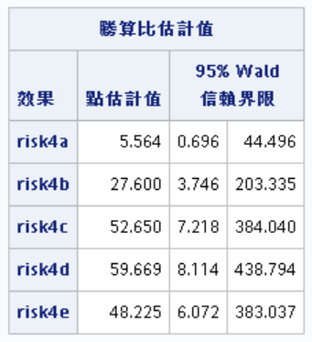
risk4 | risk4a | risk4b | risk4c | risk4d | risk4e
1 | 0 | 0 | 0 | 0 | 0
2 | 1 | 0 | 0 | 0 | 0
3 | 0 | 1 | 0 | 0 | 0
4 | 0 | 0 | 1 | 0 | 0
5 | 0 | 0 | 0 | 1 | 0
6 | 0 | 0 | 0 | 0 | 1
β_{i}
e^{βi}

Slide 9
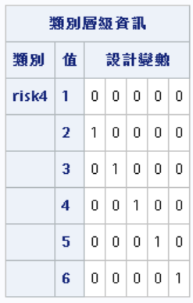
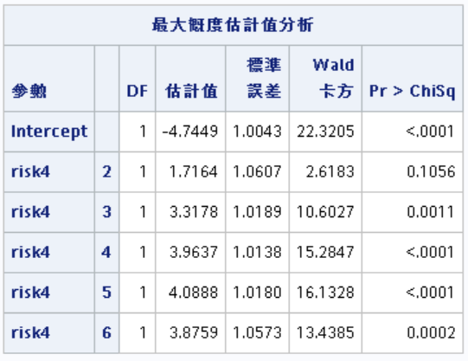
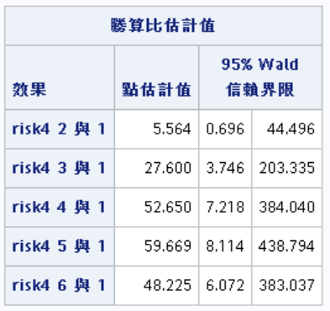
Dummy variables_2
/*dummy_2*/
PROC LOGISTIC DESCENDING DATA=a;
CLASS risk4 (ref='1') /param=ref;
MODEL case=risk4;
RUN;
reference group dummy coding
Dummy variables
β_{i}
e^{βi}

Slide 10
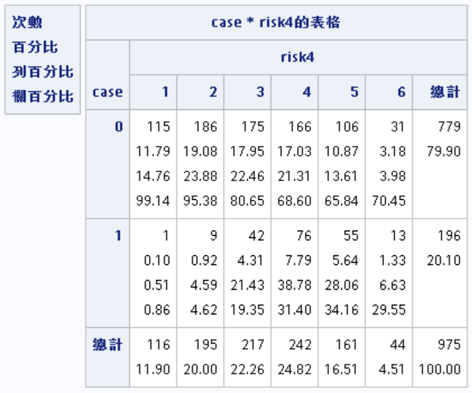
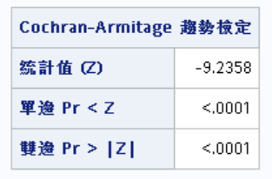
Dose-response relationship (2xk table)
/*categorical trend*/
PROC FREQ DATA=a;
TABLES case*risk4/trend;
RUN;
Cochran-Armitage trend test
H₀: no linear trend in binomial proportions of Y
across increasing levels of X
H₁: with linear trend in binomial proportions of Y
across increasing levels of X
Risk4 | smoking
1 | 0-5
2 | 6-10
3 | 11-15
4 | 16-20
5 | 21-25
6 | 25+
↑ When the direction of
the trend is unknown

Slide 11
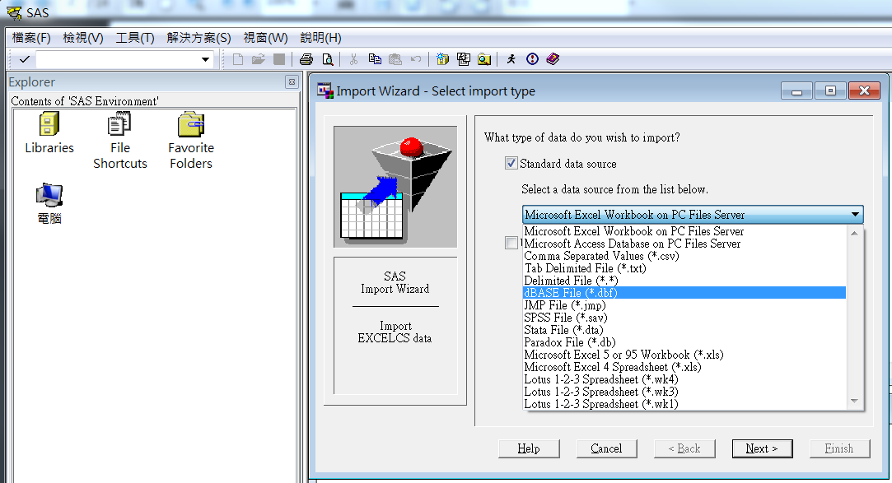
外部資料匯入
Case 3.作業資料
 [File] => [Import data] =>選擇dbf檔

Slide 12
外部資料匯入
Case 3.作業資料
SAS程式
PROC IMPORT OUT= WORK.data DATAFILE= "C:\B1CSC.dbf" DBMS=DBF REPLACE;
GETDELETED=NO;
RUN;

Slide 13
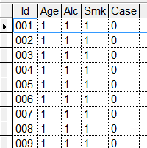
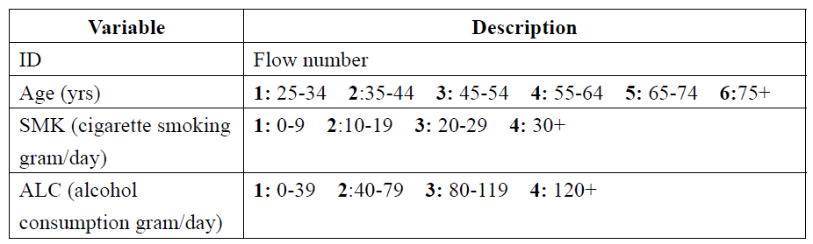
HW’s Data
Case 3.作業資料

